Slide 1
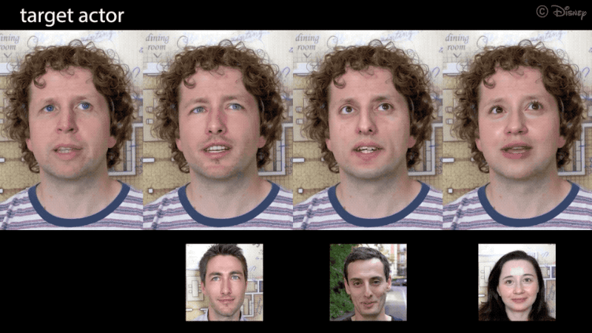
Parallel Machine Learning and Artificial Intelligence Final Project
Deepfake Detection
By Rakesh Choudhury

Slide 2
What are deepfakes?
Morphing one’s face over another
It is technique AI generated videos of people doing and saying fictional things
GANs can be used to create the deepfakes.
Deepfakes rely on neural networks that takes key features of facial expressions which can be decoded with a model trained specifically for target.

Slide 3
About Dataset
The original video dataset is available for 470GB but here 4GB video dataset is being used as training data for training the model.
This dataset is used to classify whether the video is fake or real.
There are many video files that are fake which can be observed from normal human eyes and many videos are hard to detect whether it’s fake or real.
GANs are mostly used to generate deepfake videos.
So, many videos that are fake are AI generated videos that could not be observed by normal human being.

Slide 4
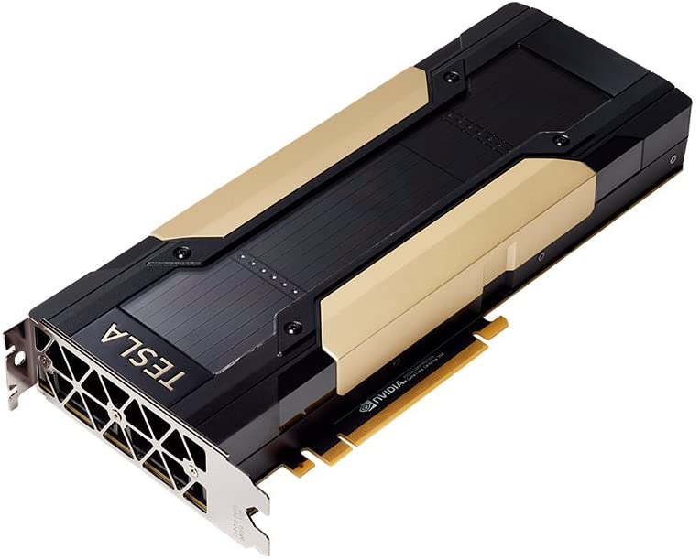

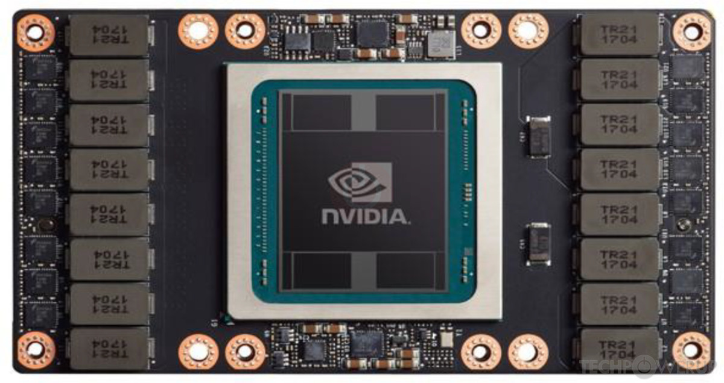
Hardware Configuration
NVIDIA v100-sxm2 GPU
24 nodes with 4 GPUs each available in cluster.
CPU type: Intel Gold 6132@2.60Ghz

Slide 5
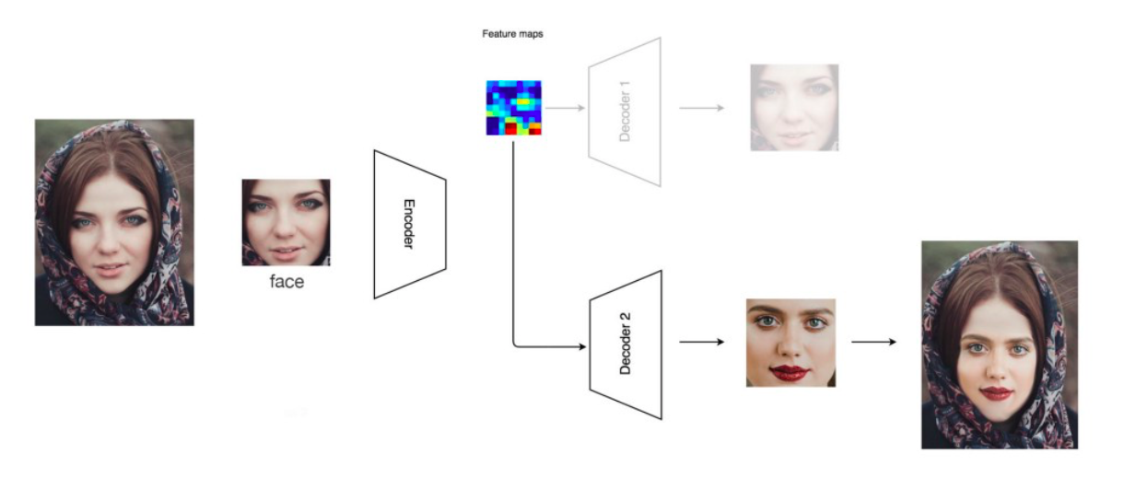
Deepfake Generation model
Source: https://jonathan-hui.medium.com/how-deep-learning-fakes-videos-deepfakes-and-how-to-detect-it-c0b50fbf7cb9

Slide 6
How to detect deepfakes?
The openCV library detects the face from the video frame
The model extracts the facial features using blaze face and media pipe library that detects in-depth facial features.
Those features are trained and fed into the model and gives out a score to each video.

Slide 7


Library Used
Pytorch is used for image processing, helps in accelerating process using GPU and uses multiprocessing to .
OpenCV is used for the facial recognition in order to capture face from different frames of the videos.
Other libraries like blaze face and mediapipe are object detecting libraries that can detect objects and faces in videos in realtime.

Slide 8
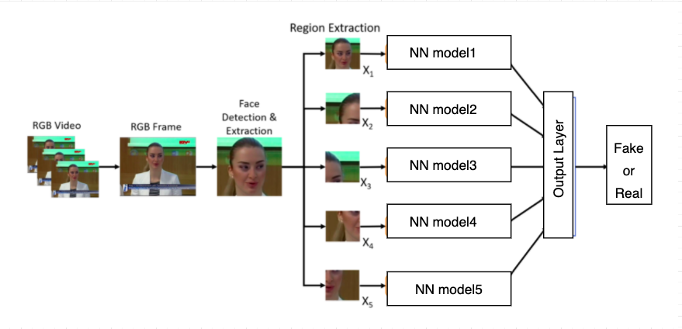
The workflow

Slide 9
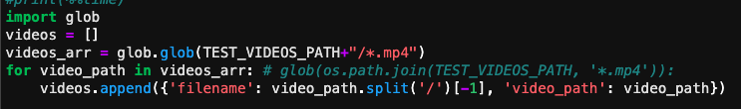
Implementation and Methodology
A pandas dataframe is created to store the filename and its corresponding path.
This dataframe will be used by other functions to retrieve the video from a particular path.

Slide 10
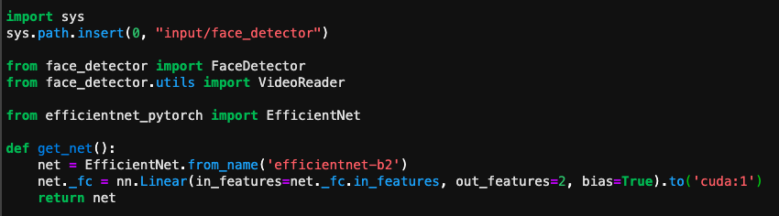
This extracts the facial features from the frames collected from the videos.
This function runs on a dedicated GPU “cuda:1”

Slide 11
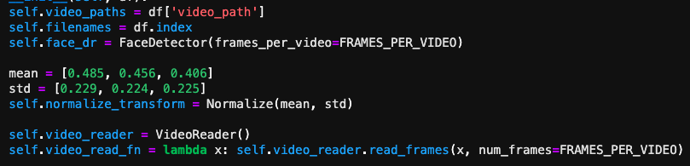
This code is part of dataretriever class that uses the pandas dataframe to retrieve the video from the defined path.
It uses different functions like face detector for detecting faces from different frames of the video.
It also normalizes the matrix obtained from the video frames.

Slide 12
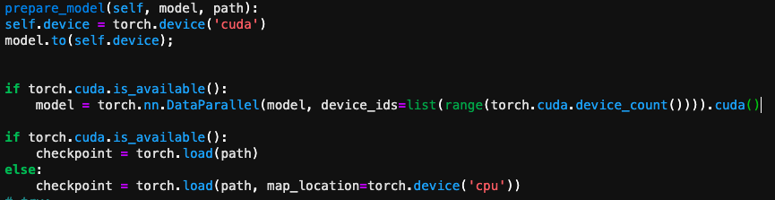
This function prepares the pytorch neural network model.
This model is configured to run on multiple GPUs.
This model uses the Pytorch’s DataParallel to run the different chunk of data in different GPUs

Slide 13
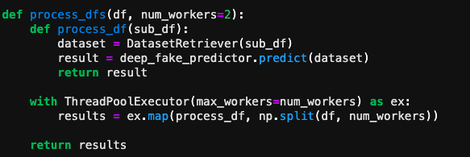
The deepfake predictor class is run over the video dataset that will be feeding the videos into the neural network model.
This will give an output in the range of 0 to 1 where the score near to 0 to 0.5 are considered as real video and score near to 0.5 to 1 is considered as fake video.
The process time is also calculated for running the training dataset on the model.

Slide 14
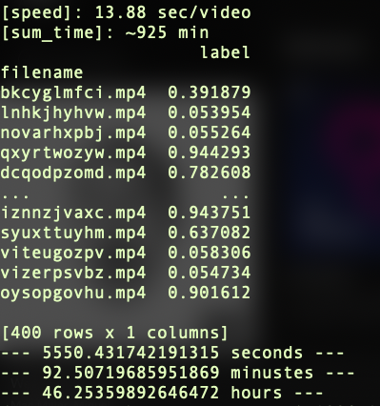
Process time Serial Performance
This is the output of a serial code which almost takes 1 hour 32 mins processing time.
The serial code takes processing 13.88 sec for processing one video on an average.
The output also consist of prediction score of each from the training data.

Slide 15
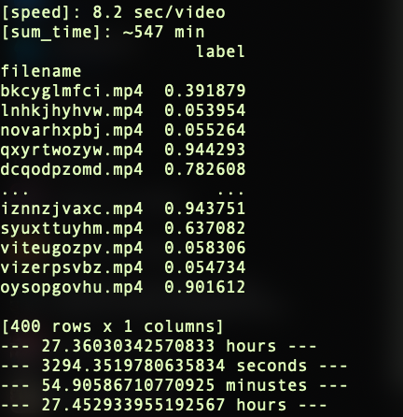
Performance Parallel Time
This is the output of a parallel code which almost takes 54 mins processing time.
So here the speedup performance is 92 mins/54 mins = 1.7
It took 8.2 sec on an average to process each video
Pytorch provides functions to run the code in multiple GPUs.
This is huge improvement while using 4 GPUs to run this code.

Slide 16

Thank You!
Have a great Day!

